Slide 1
Evacuation Route - Toh Tuck Wing Campus

Slide 2
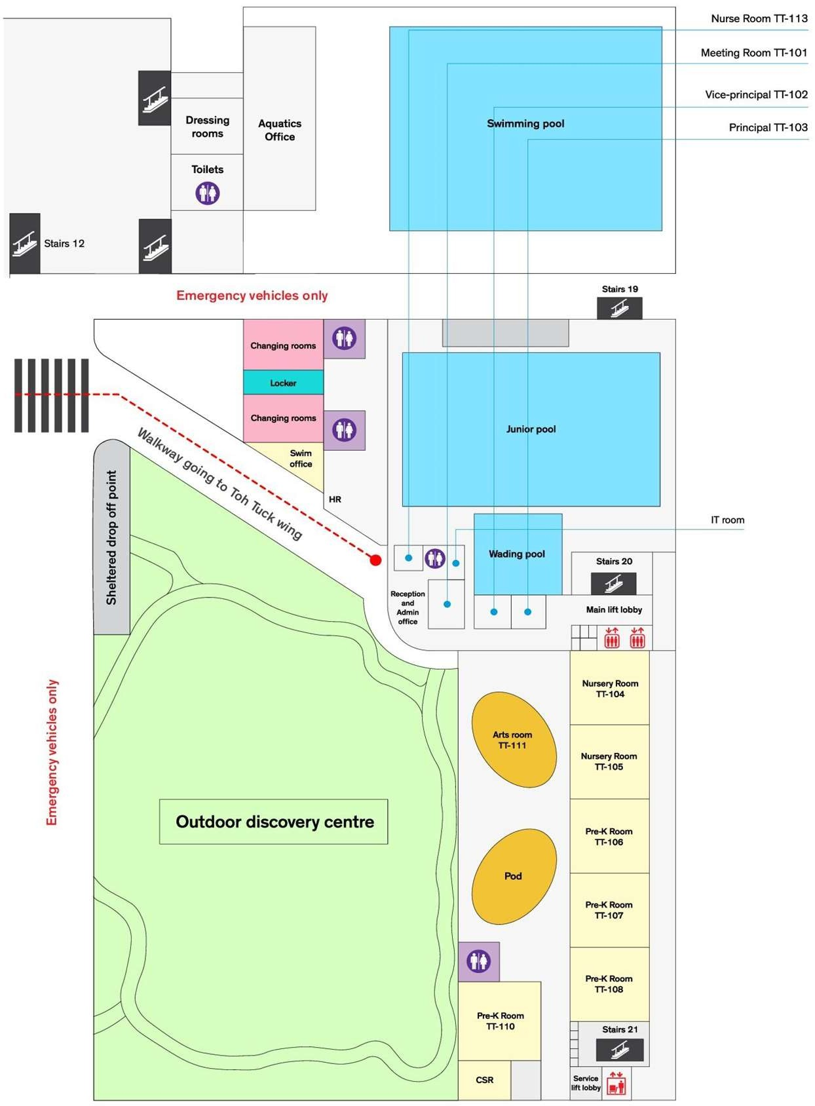

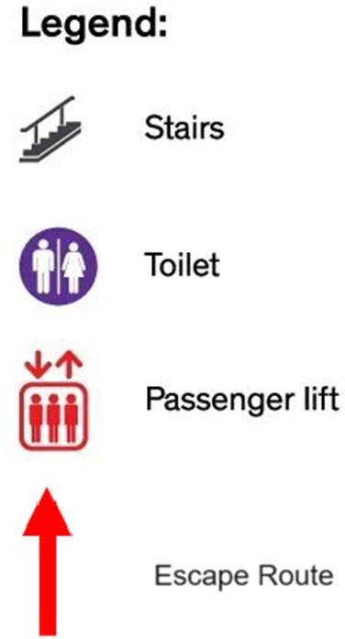

School Emergency Assembly Area (Covered Carpark)

Slide 3
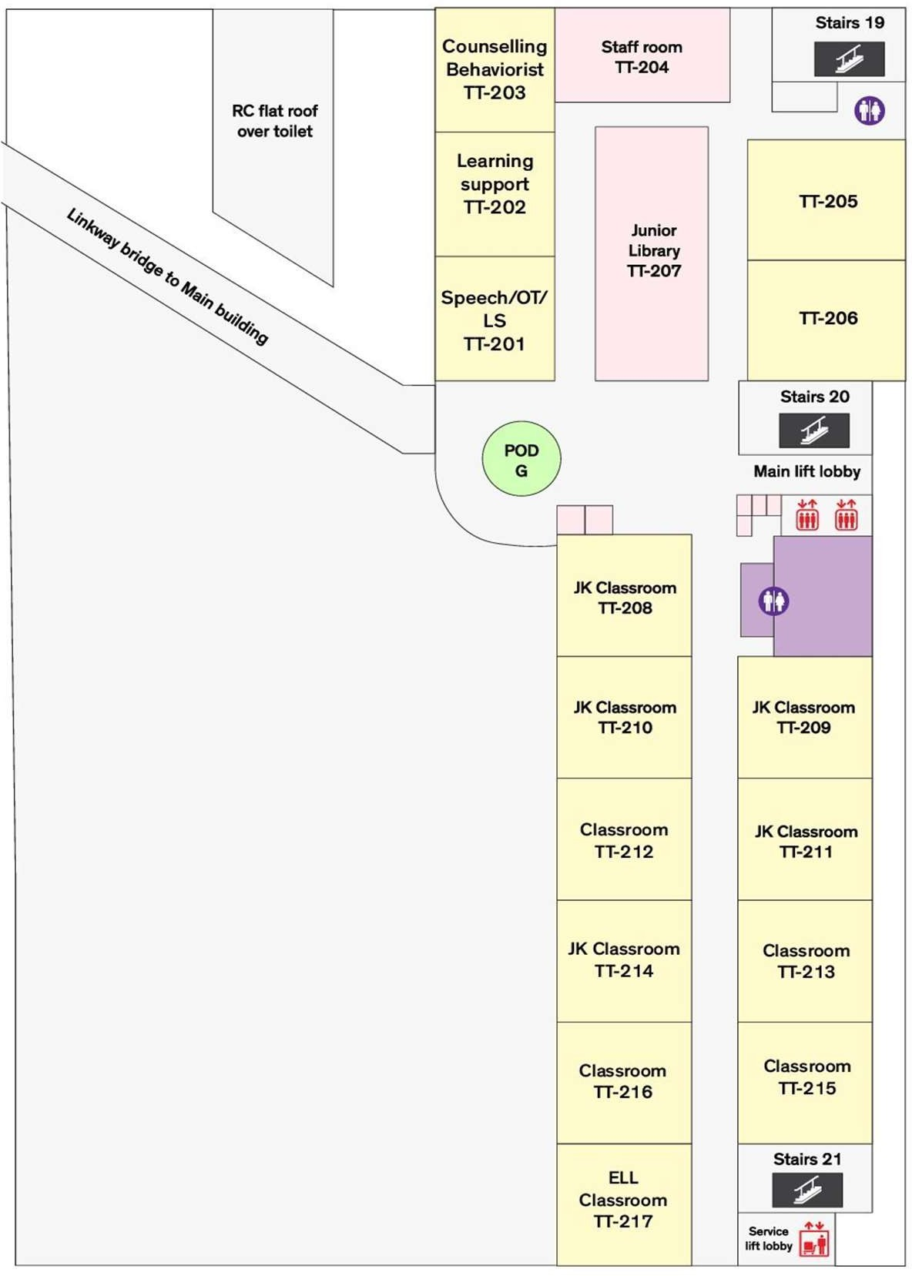
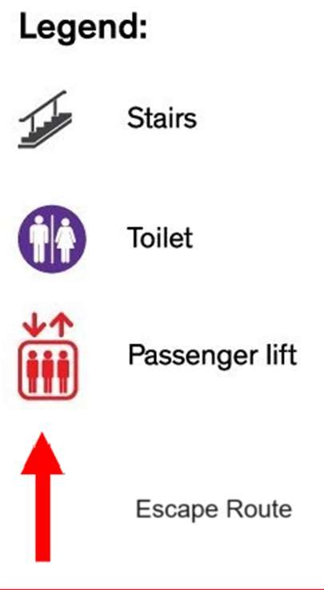


Slide 4
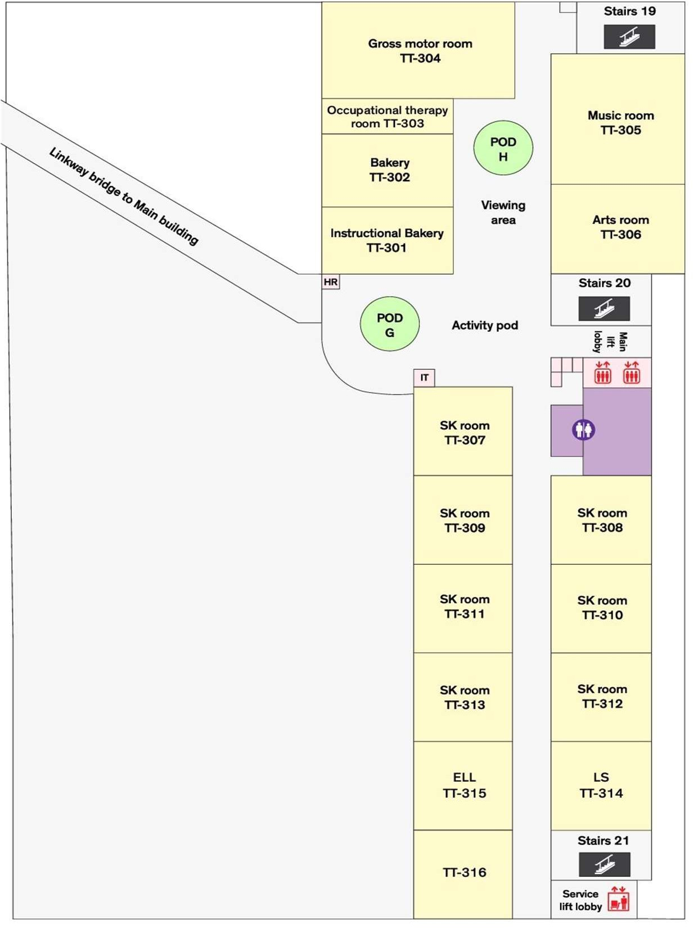
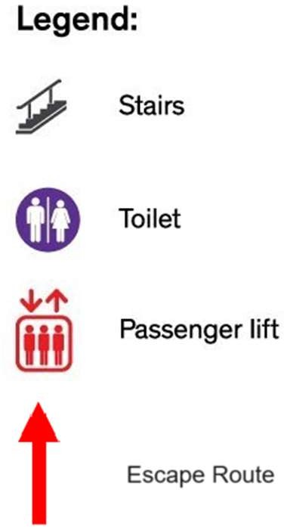


Slide 5
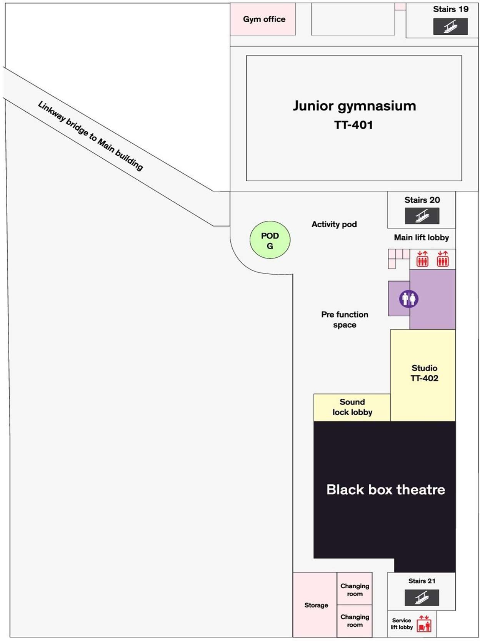



Slide 6
Evacuation Route - Lakeside Campus

Slide 7
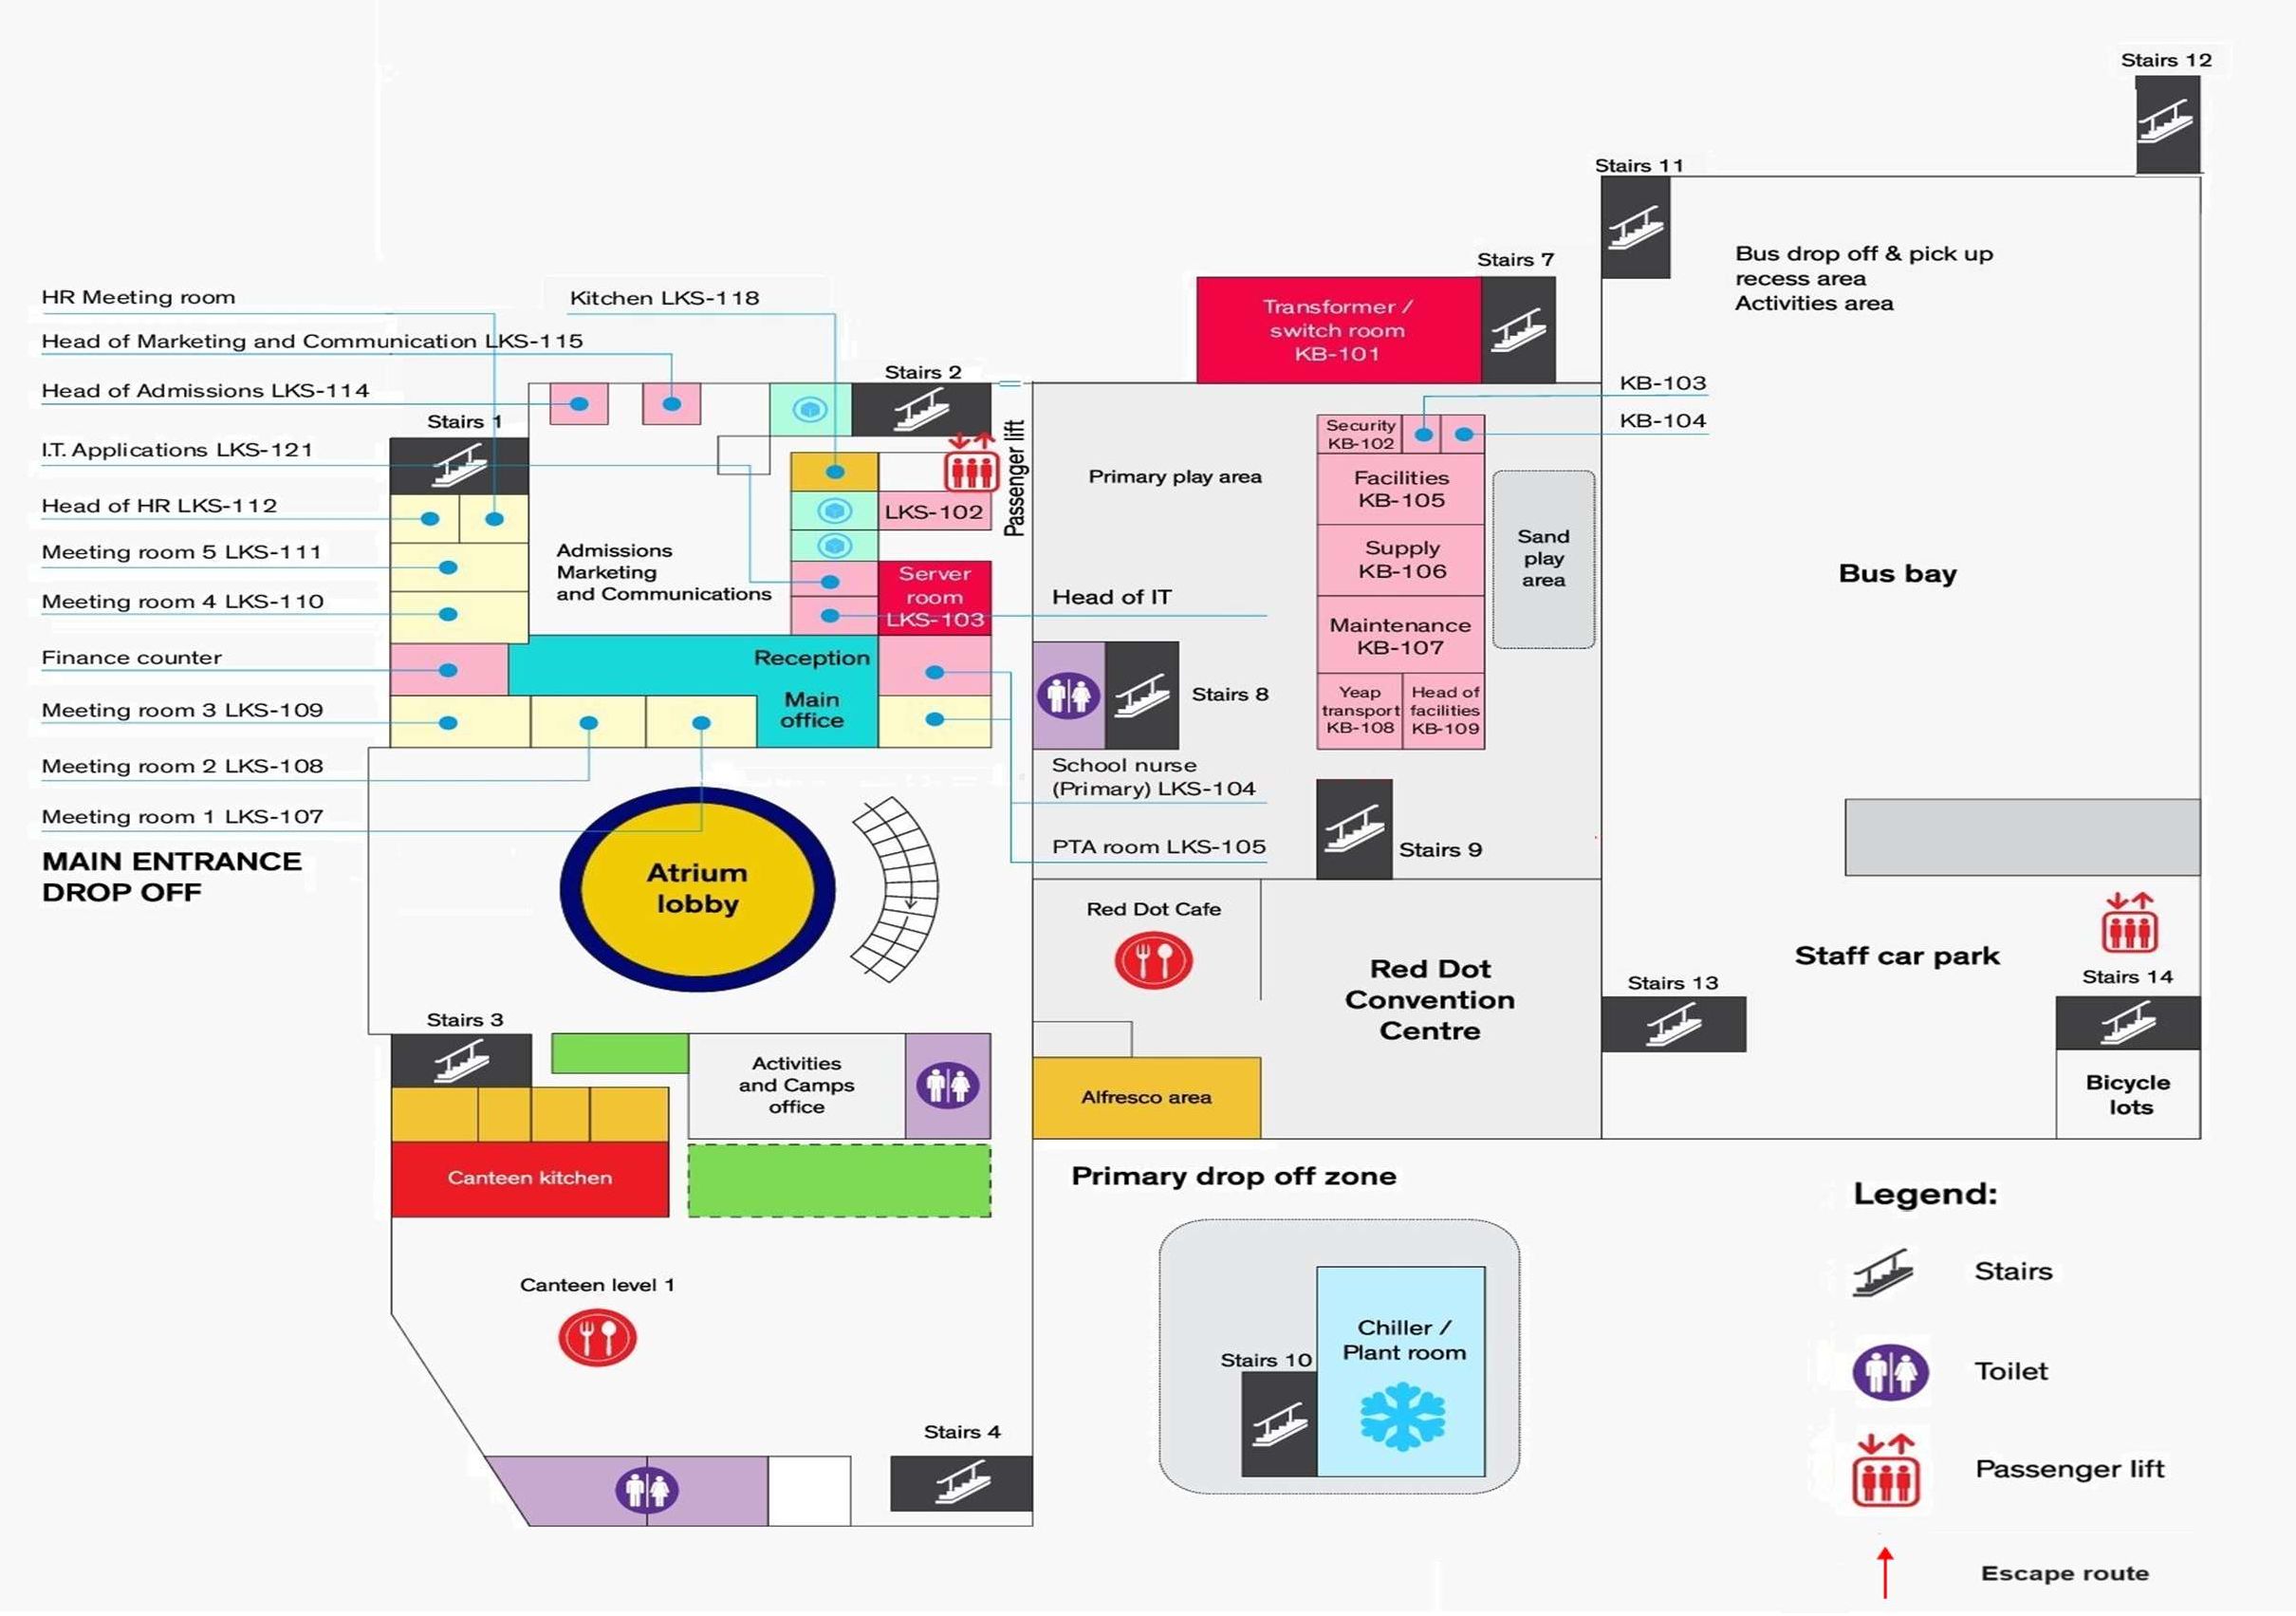
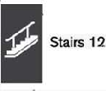

School Emergency Assembly Area
(Covered Carpark and Sheltered Basketball Court)

Slide 8
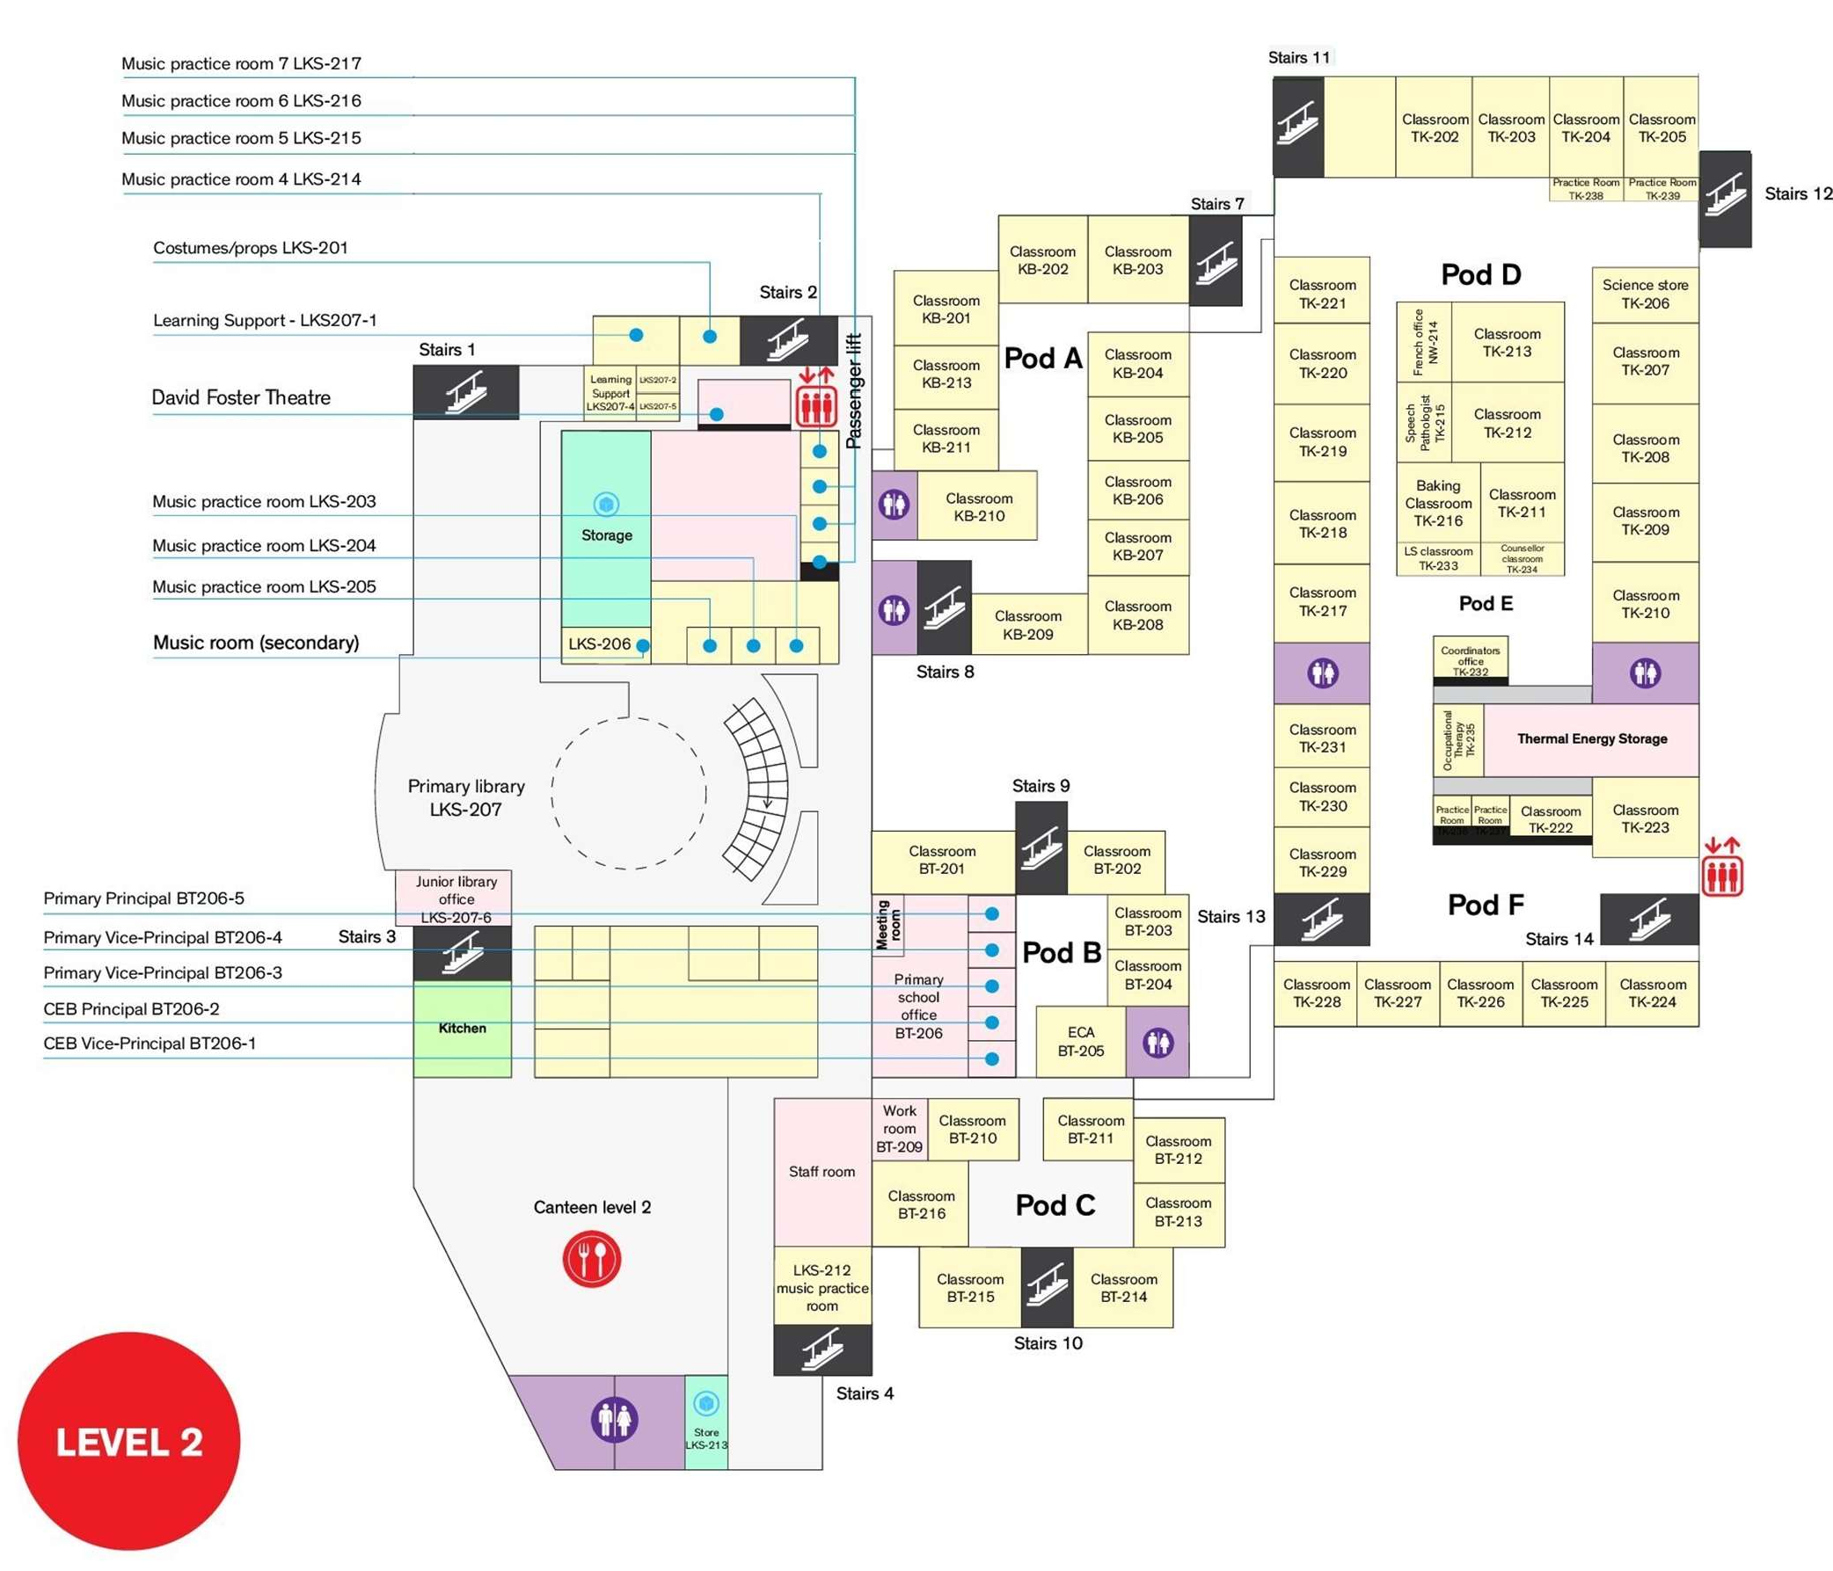
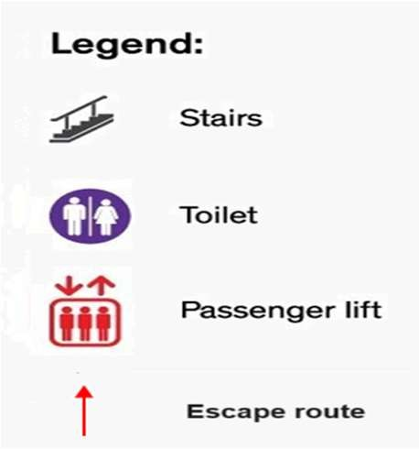


School Emergency Assembly Area
(Covered Carpark and Sheltered Basketball Court)
Description: Canadian International School Lakeside campus building layout (Evacuation Route)
Robin Yip (Version: Nov 24)

Slide 9
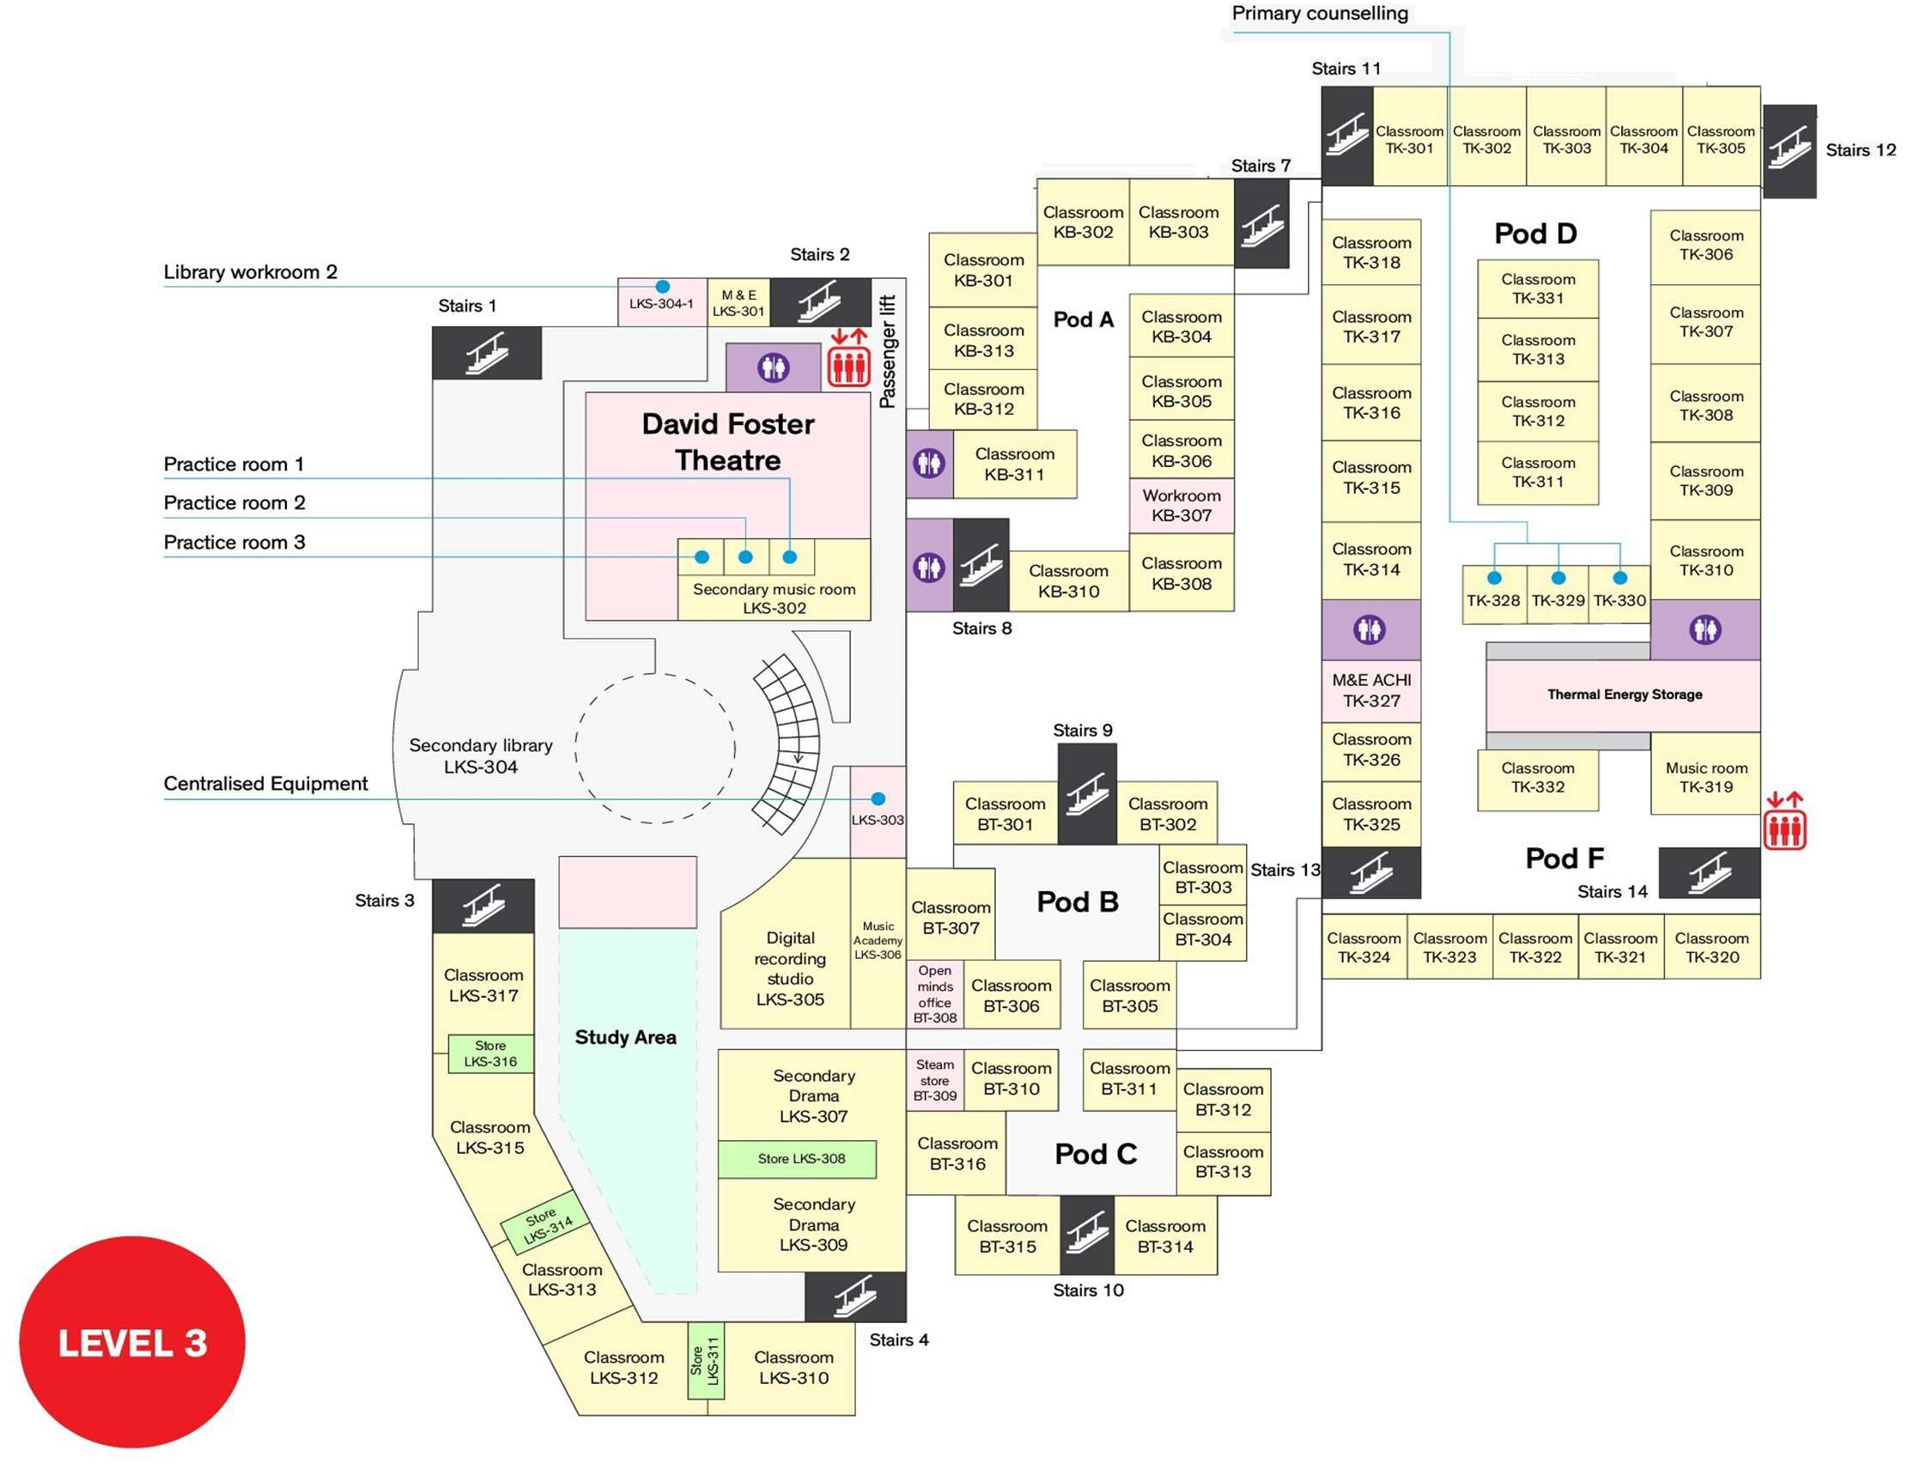


School Emergency Assembly Area
(Covered Carpark and Sheltered Basketball Court)

Slide 10
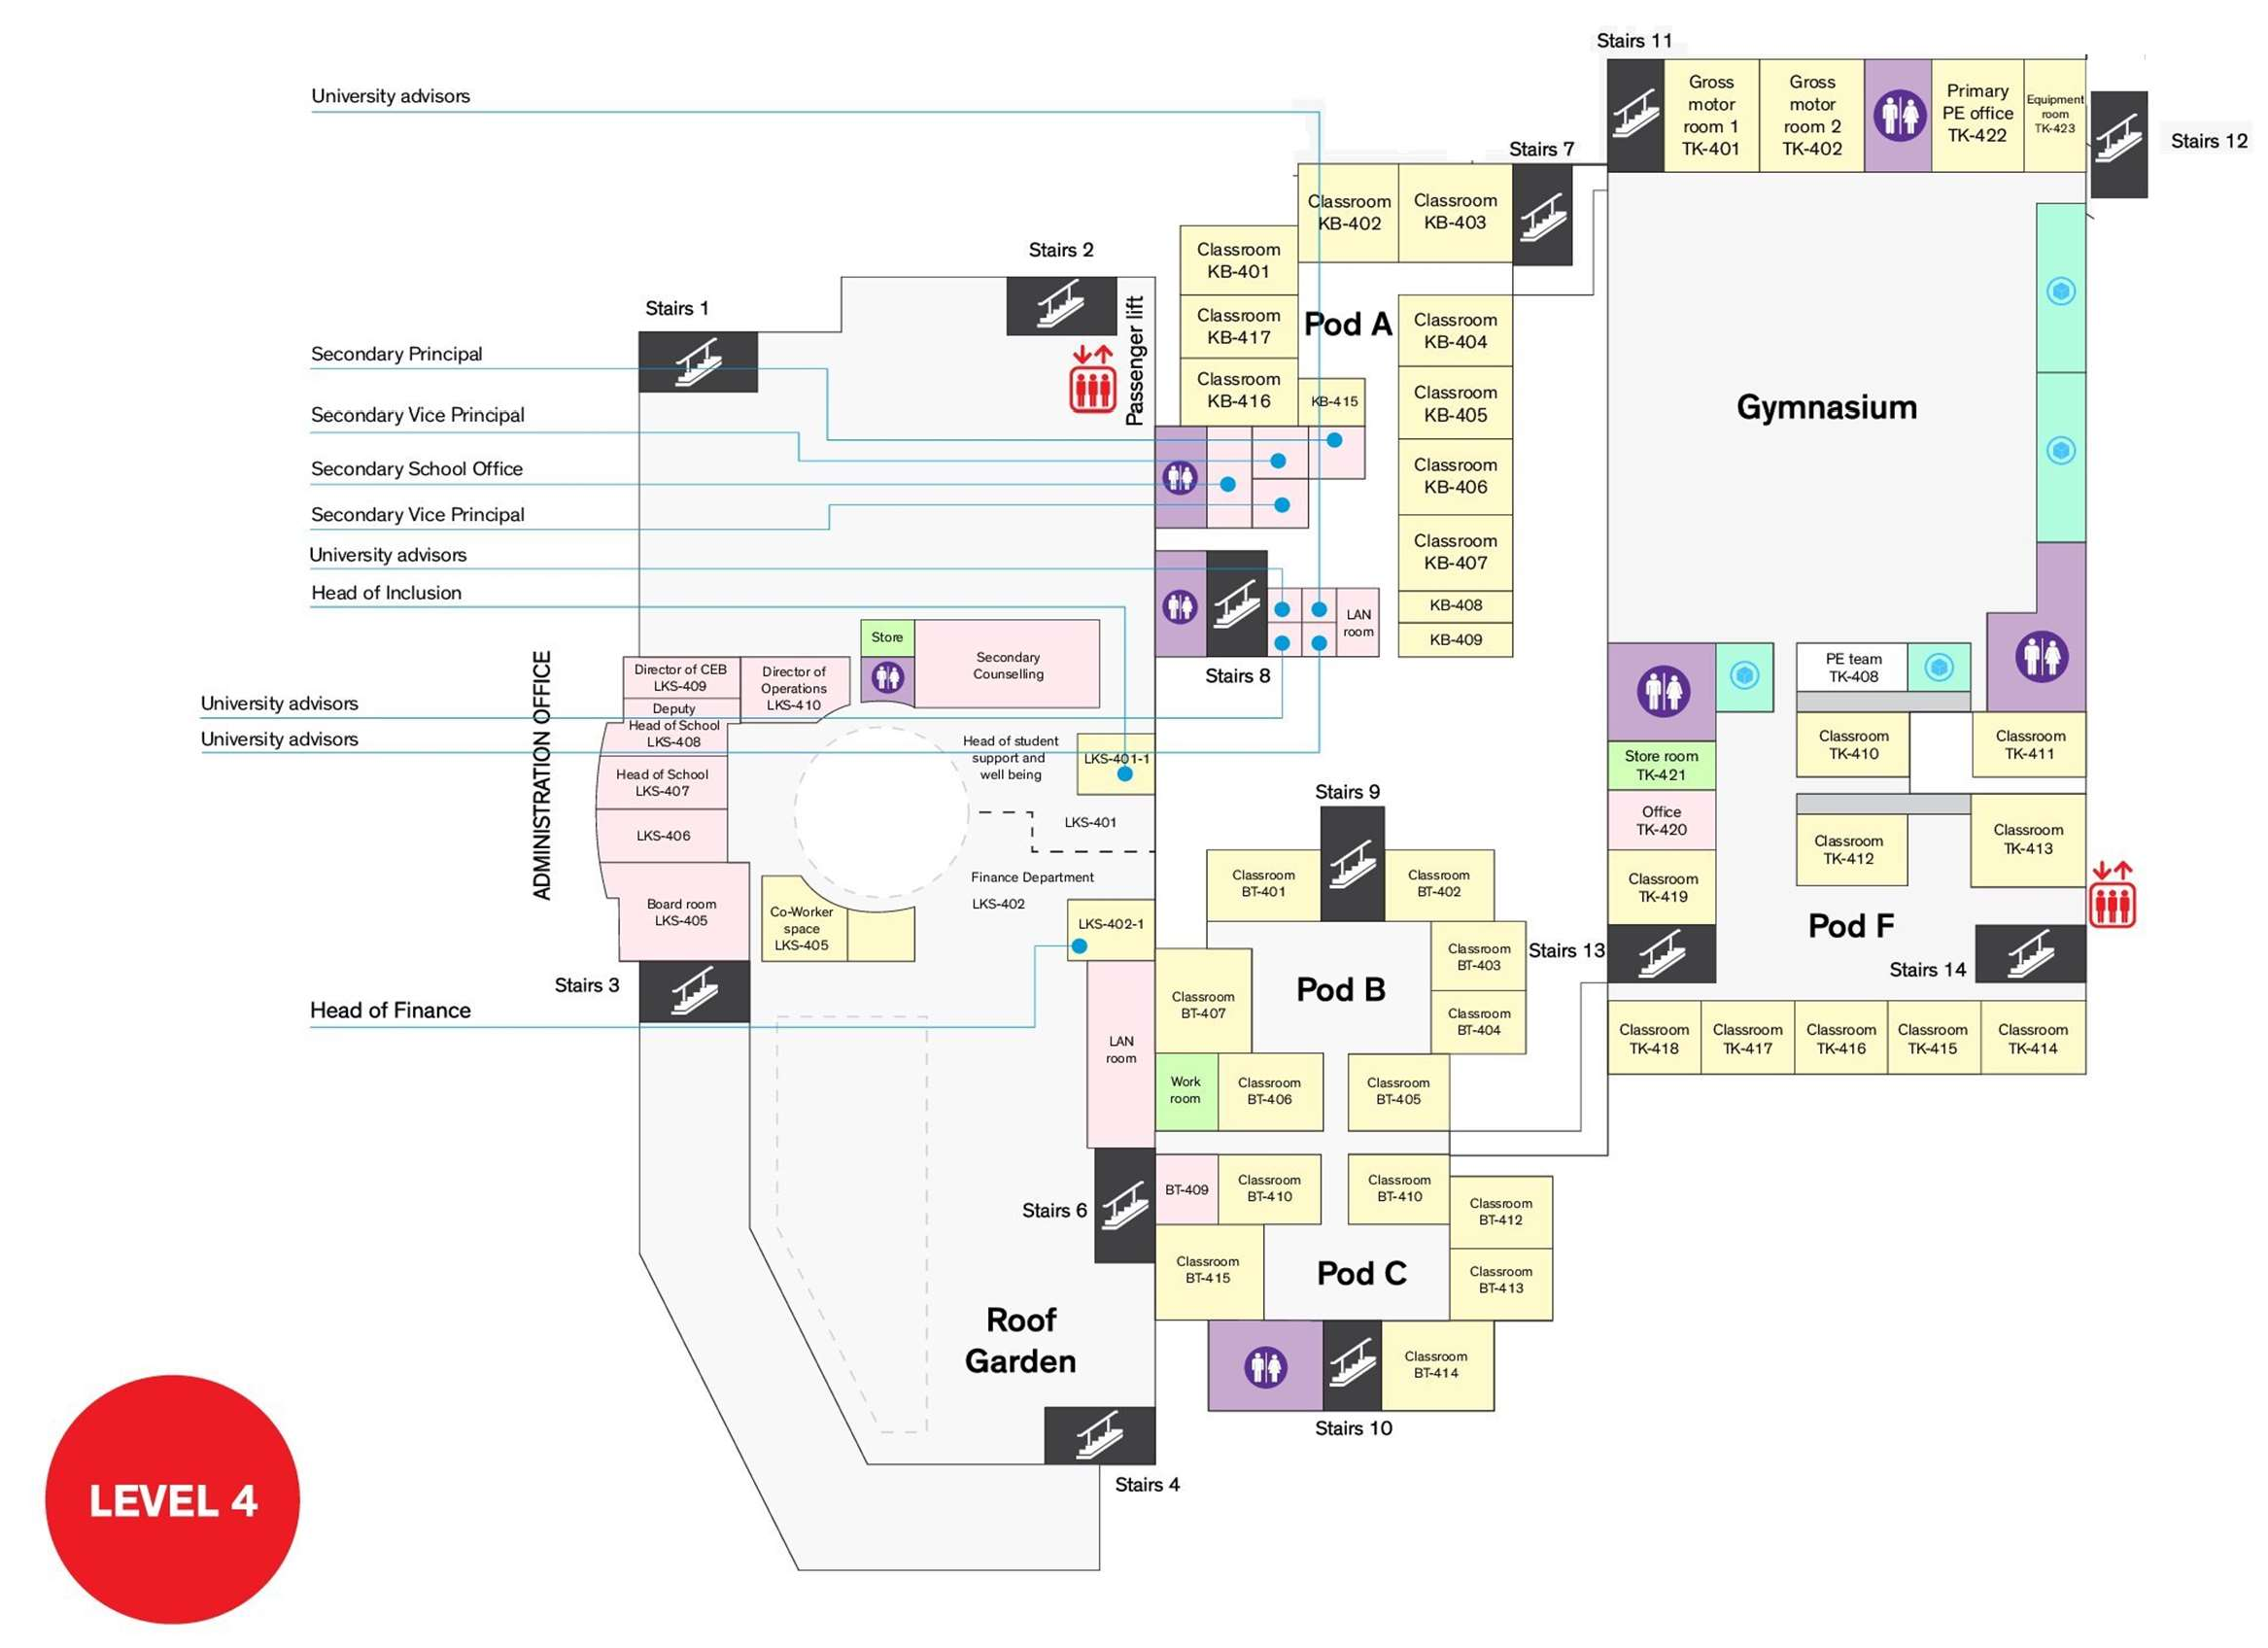

School Emergency Assembly Area
(Covered Carpark and Sheltered Basketball Court)

Slide 11
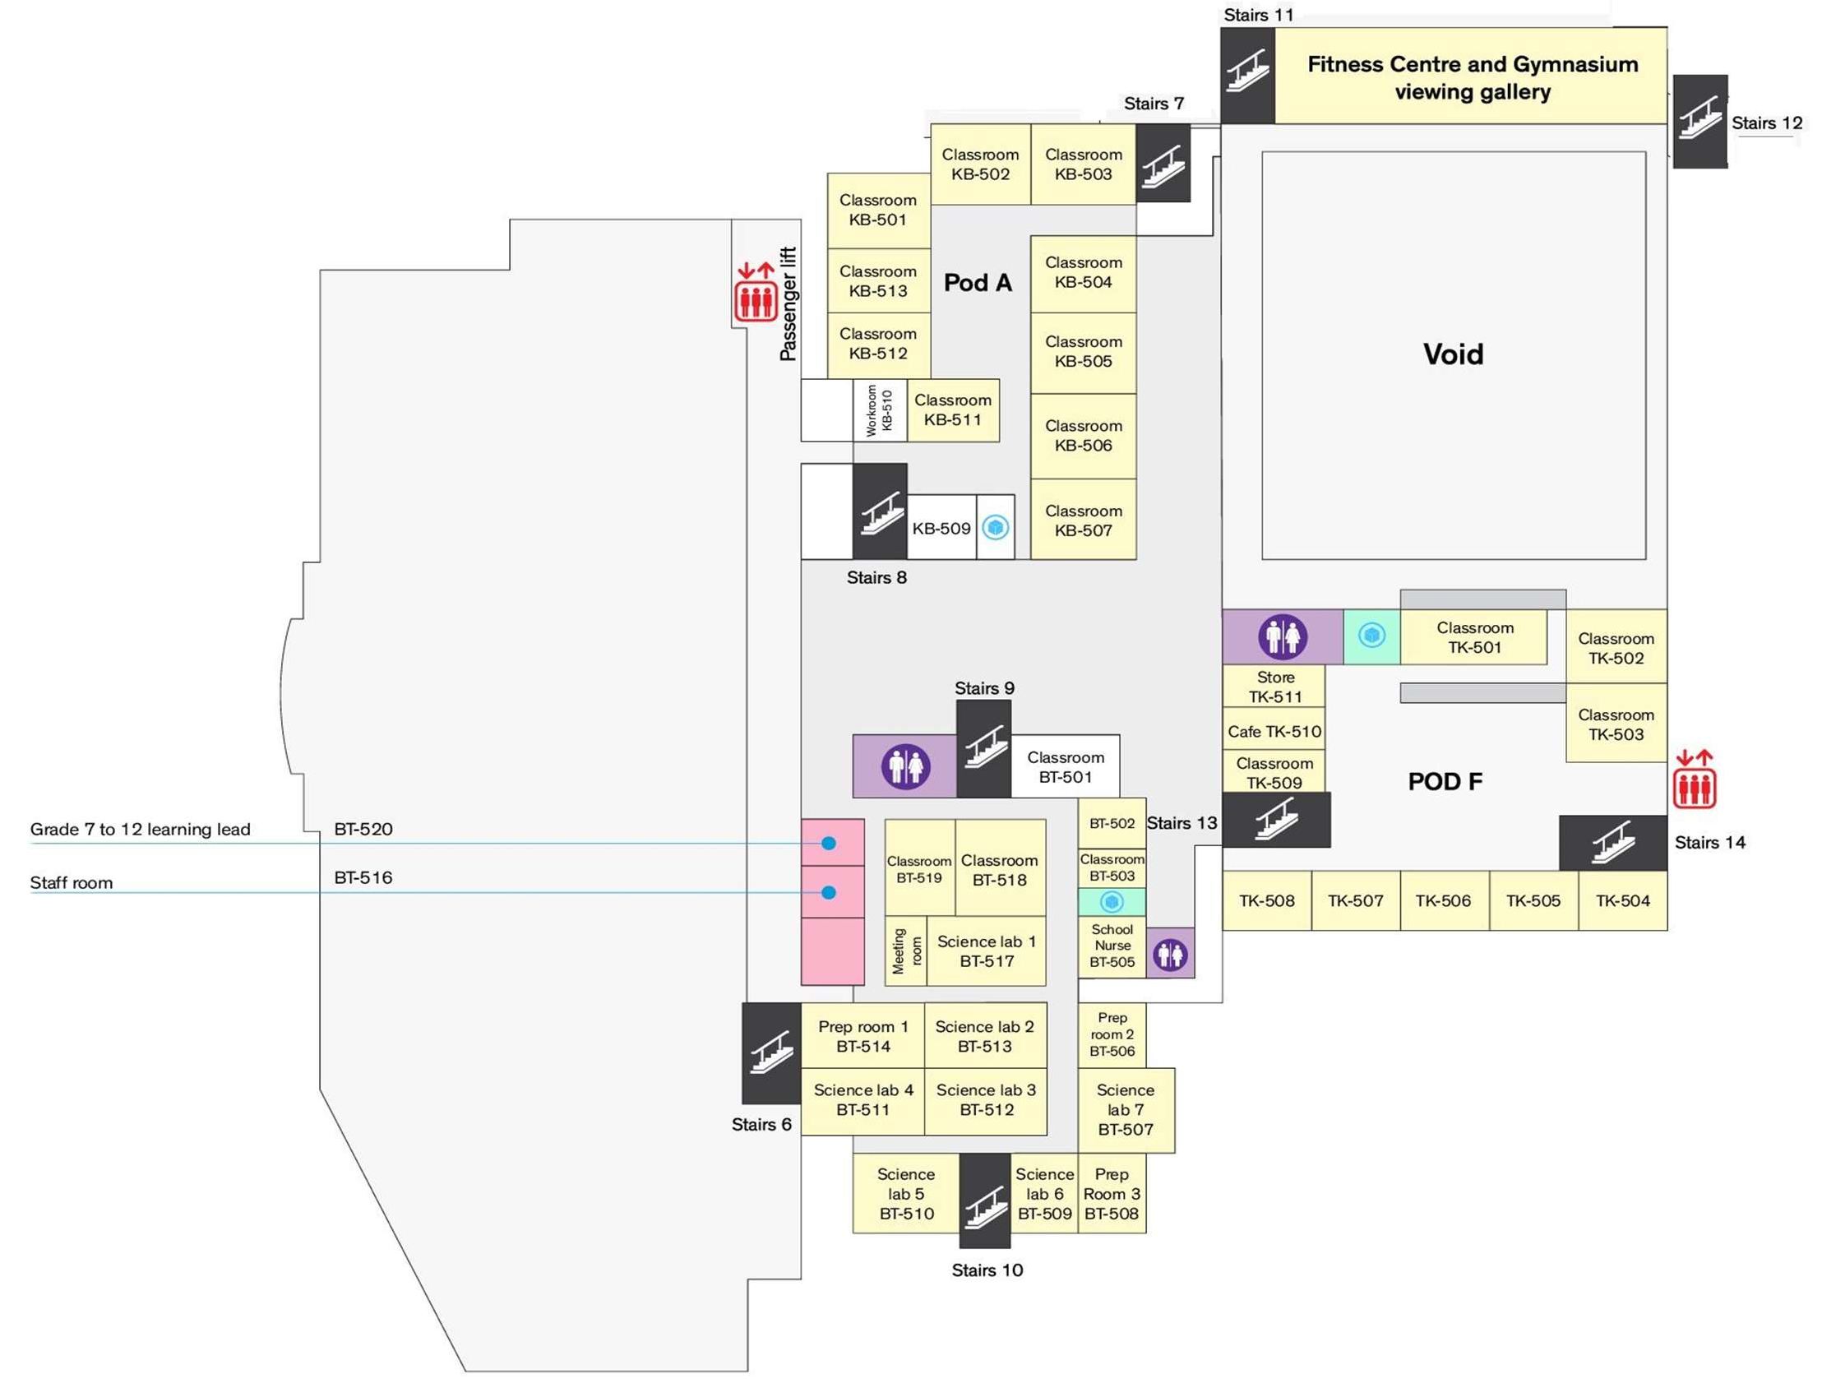

School Emergency Assembly Area
(Covered Carpark and Sheltered Basketball Court)
Description: Canadian International School Lakeside campus building layout (Evacuation Route)
Robin Yip (Version: Nov 24)

Slide 12
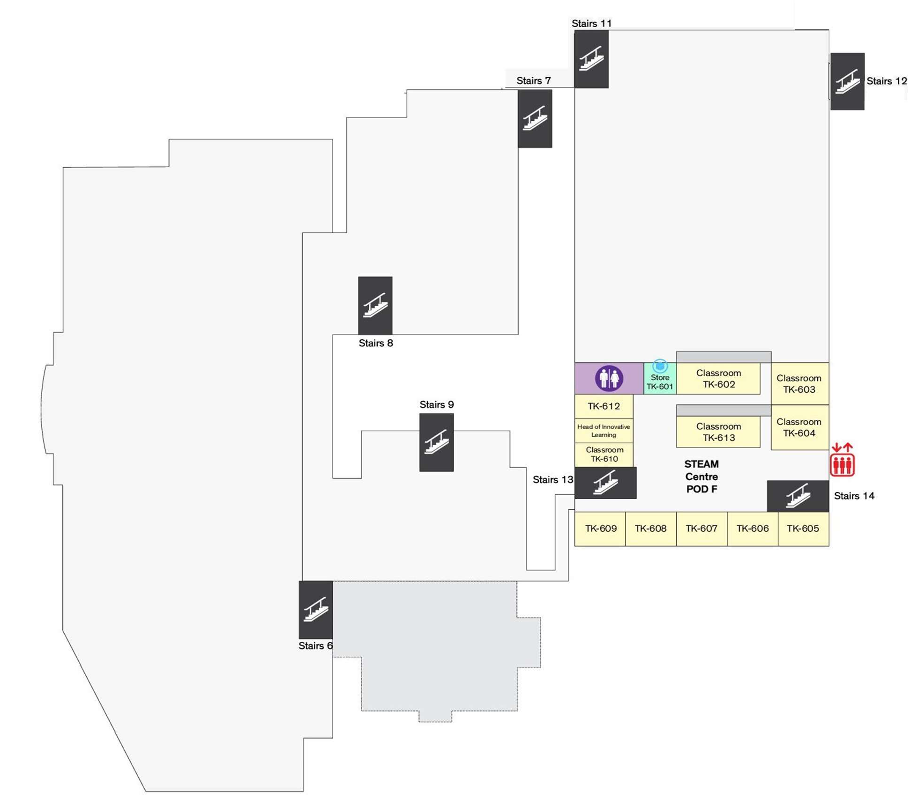



School Emergency Assembly Area
(Covered Carpark and Sheltered Basketball Court)

Slide 13
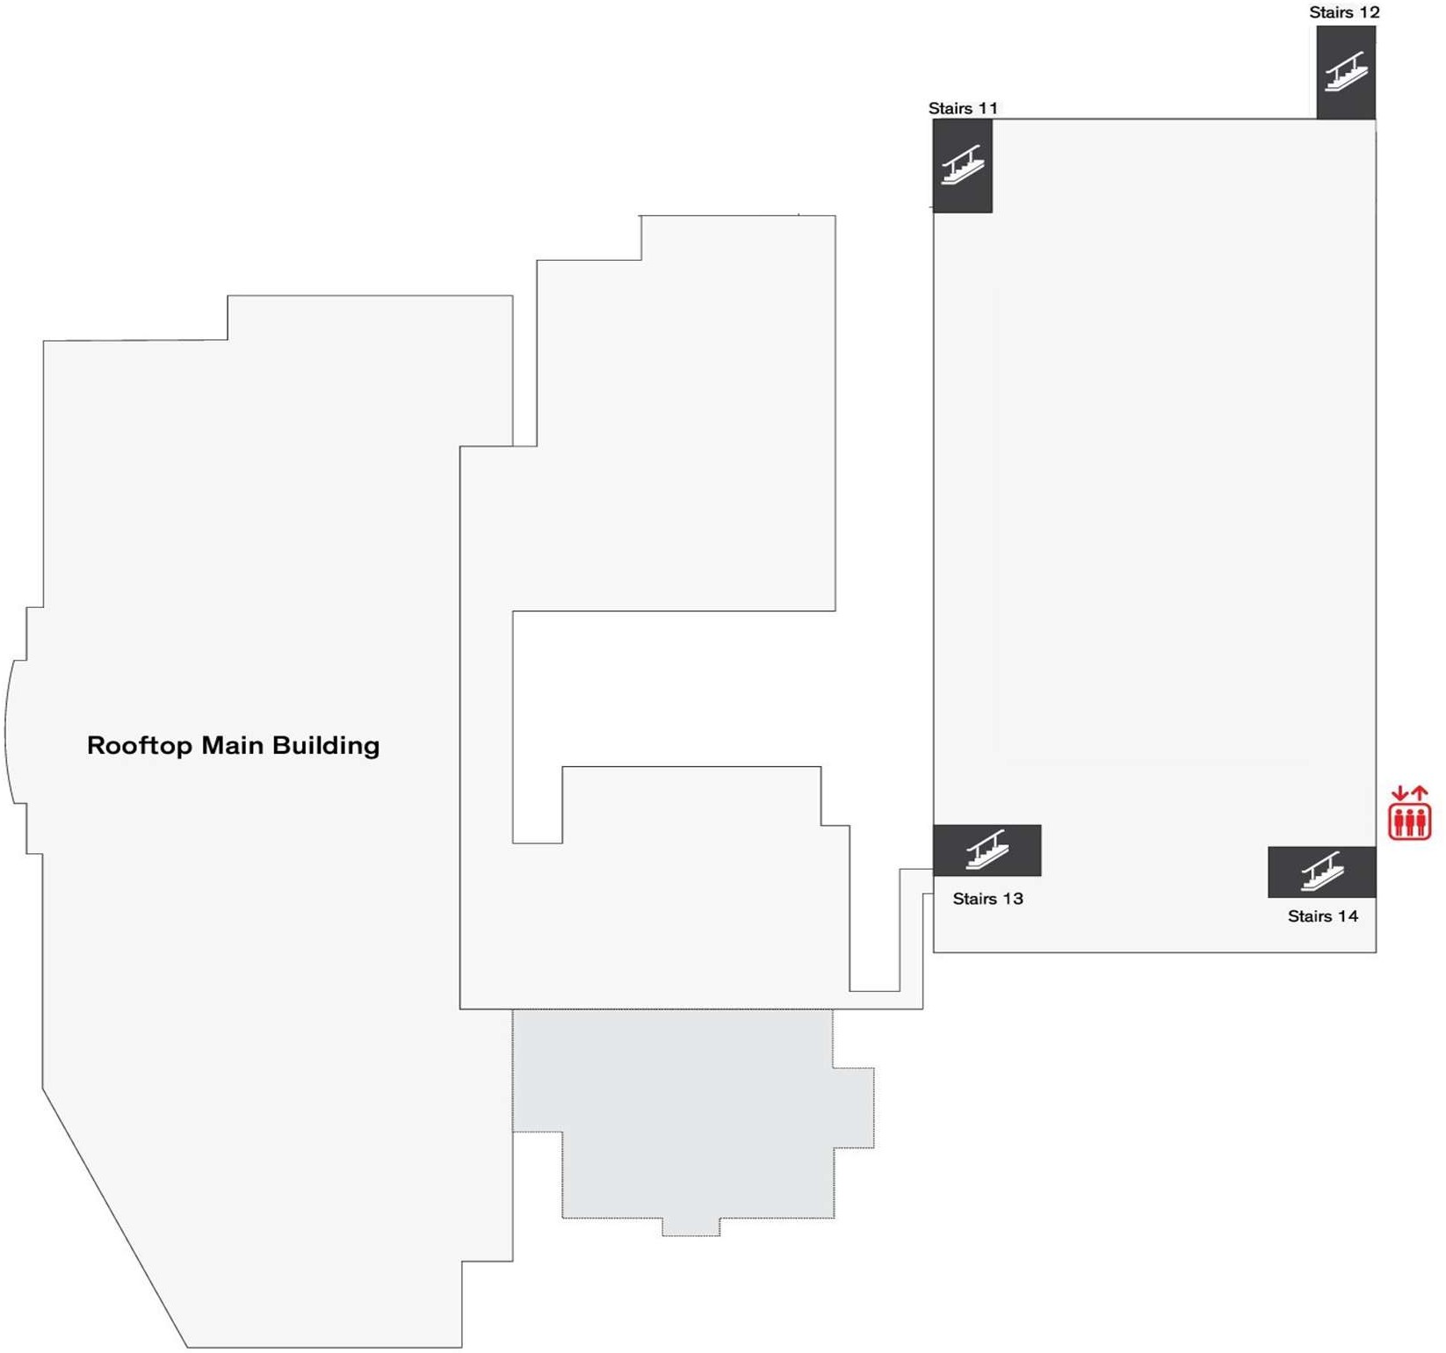
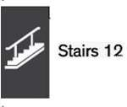


School Emergency Assembly Area
(Covered Carpark and Sheltered Basketball Court)

